Slide 1
About National Self-Care Week (18 – 24 November)

Slide 2
National Self-Care Week
A national awareness week focusing on embedding support for self-care across communities, families and generations
Organised by the Self Care Forum since 2011
800+ organisations participate each year
Supports people’s understanding of self-care
Power of many voices joining under 1 message
2024 theme is Mind & Body

Slide 3
What is the Self Care Forum?
Small UK Charity – 17 board members + 1 employee
Aim - further the reach of self-care and embed it in daily life
Raises awareness of self-care
Produces free resources for health organisations and health professionals
Shares best self-care practise
Collaborates with others passionate about self-care

Slide 4
What is self-care?
The actions that individuals take for themselves and on behalf of or with others to develop, protect, maintain and improve their health, wellbeing or wellness. (Self Care Forum definition of self-care)

Slide 5
Self-care is not “no care”
Self-care is about individuals understanding and practicing activities that protects their physical health and wellbeing
Self-care does not mean abandonment, it is supported care, empowerment and control
People mustn’t feel or be made to feel like they cannot seek help and support from health professionals

Slide 6
Practicing Self-care helps you and your family
Make exercise part of your routine
Ensure you don’t miss screening appointments
Try to eat healthily
Quit smoking
Be aware of symptoms of ill health and how long they normally last and understand when you should seek professional help
Stay connected to friends and family
Don’t be afraid to ask for help from friends, family or health services

Slide 7
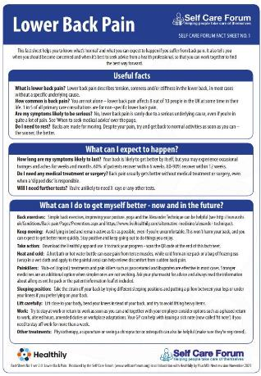
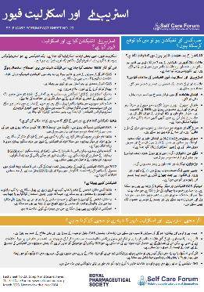
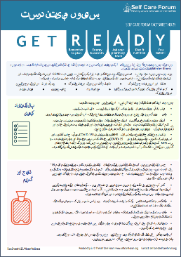
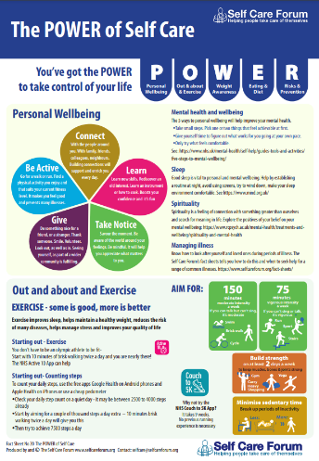
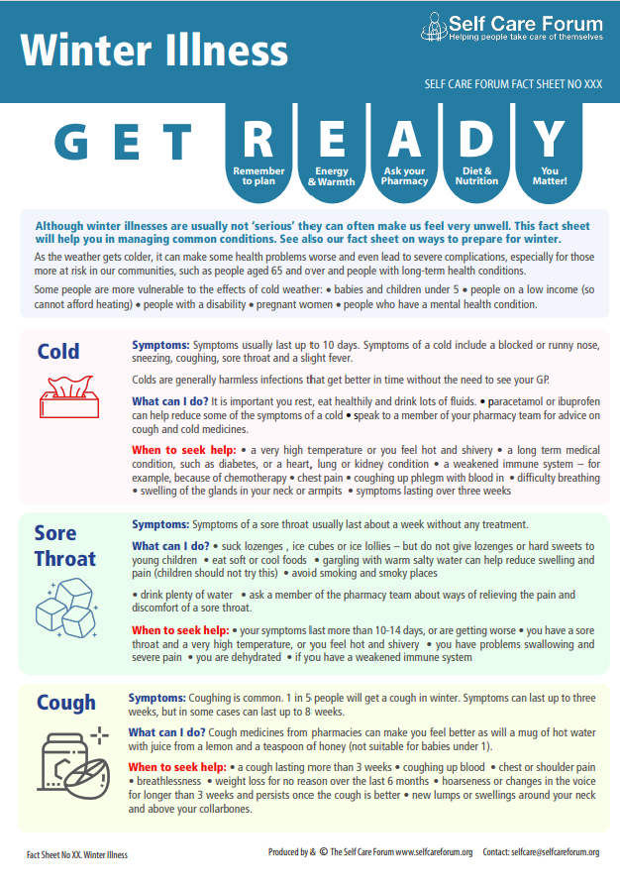
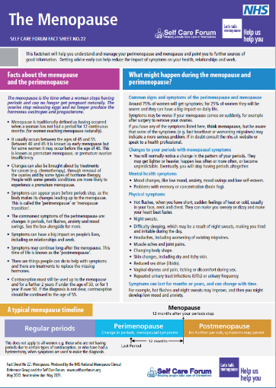
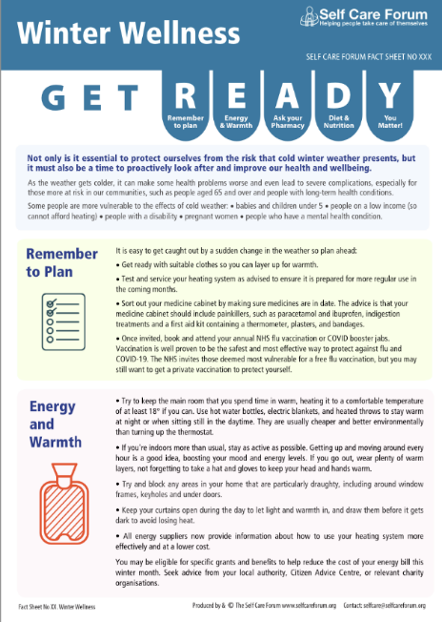
Self care forum’s Self-care fact sheets
Helps people understand how long symptoms last, and the red flags
26 Self-Care Aware Fact Sheets
Trustworthy health information
Common ailments and food supplement focused

Slide 8
Self-care for life.

